Slide 1
What is SEO or Why You Need Google on Your Team?
By Kenneth von Rauch
Notes:
Hey guys, it's Ken from WebDesy.com. This slideshow is about the basics of SEO and why you need it. Let's get the ball rolling!

Slide 2
SEO (Search Engine Optimization)
Make sure that search engines like your site
Notes:
SEO stands for Search Engine Optimization, which basically means doing whatever possible to make sure that the major search engines like your site and show it to potential clients as often as possible. I'll explain how to do it in my upcoming posts on WebDesy.com

Slide 3
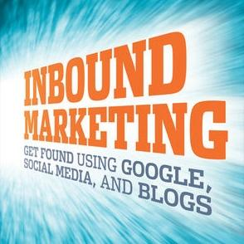
SEO -> Inbound Marketing
Better Name
Notes:
Since SEO is associated with slightly indecent tactics, there's a trend to say inbound marketing instead of SEO.

Slide 4
Rankings
Rankings are basically the places that your site pages occupy in Google.
Notes:
Rankings are the main metrics in today’s SEO, because it defines whether you have traffic for your site or not. If you have traffic, you can monetize it the way you like. You may want to sell ebooks, offer consulting services, etc.

Slide 5
Why Google is Your Friend
Google
Bing
Yahoo
Baidu (China)
Yandex (Russia)
Notes:
It’s the biggest search engine nowadays. Sure thing, there are others as well, but they are either smaller (for instance Bing) or just local ones (for example Yandex in Russia and Baidu in China).

Slide 6
On-page and Off-page SEO
On-page SEO is all about what you need to do on your site to optimize it for search engines.
Off-page SEO is what you need to do off your site to improve your site’s SEO rankings (such as building links, etc).

Slide 7
SEO Hat Fashion
White Hat = Good
Gray Hat = Tricky
Black Hat = Bad
Notes:
The things that are OK to apply are within the white-hat SEO, those that Google forbids are in the realm of black-hat SEO. And gray-hat SEO is everything in between.

Slide 8
WebDesy@gmail.com
Let us know if you have questions
Notes:
I hope you liked the slideshow. Let me know if you have any questions or ideas.

